Slide 1
What are the Dutch municipalities that have an average household income above EUR 40000?
All icons by: https://www.flaticon.com/
Notes:
1

Slide 2
Unit 3.2: Files and Pandas
All icons by: https://www.flaticon.com/
Notes:
2

Slide 3
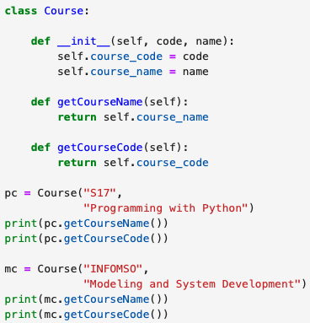
Last lecture
Notes:
3

Slide 4
Last lecture
How to initialize?
Notes:
4

Slide 5


This lecture
Notes:
5

Slide 6
This lecture
string
int
Notes:
6

Slide 7
This lecture
string
int
for
while
Notes:
7

Slide 8
This lecture
string
int
for
data structures
while
functions
functions
Notes:
8

Slide 9

This lecture
string
int
for
data structures
while
functions
functions
Notes:
9

Slide 10

This lecture
string
int
for
data structures
while
functions
functions
Notes:
10

Slide 11

This lecture
string
int
for
data structures
while
functions
functions
Notes:
11

Slide 12
This lecture
DATA
INFORMATION
Notes:
12

Slide 13
What are the Dutch municipalities that have an average household income above EUR 40000?
All icons by: https://www.flaticon.com/
Notes:
13
Take ideas and write them down
If they mention ChatGPT, show them my attempts and these notes:
Problems with ChatGPT:
- format
- froze
- refused to give answer
- adapted question means making the query again
- data might be private

Slide 14
This lecture
Reading Files
CSV Files
Notes:
14
At this point, stop the presentation, open the dataset file, and pose the question again: What are the Dutch municipalities that have an average household income above EUR 40000?
What are the challenges now?

Slide 15

File Input/Output (I/O)
Notes:
15
At this point, stop the presentation, open the dataset file, and pose the question again: What are the Dutch municipalities that have an average household income above EUR 40000?
What are the challenges now?

